Slide 1
If Crisis or War Comes
Our shared preparedness

Slide 2
Notes:
FACTS: The brochure If Crisis or War Comes was sent out to 4.8 million households as part of the national information campaign Crisis Preparedness Week at the end of May/start of June 2018. MSB got to decide when the brochure would be sent out.
BACKGROUND
In 2017, MSB was commissioned by the Government to produce national information material for Swedish households. The Government issued the commission based on a need to:
increase the knowledge on how to prepare for various crises, heightened alert levels, and ultimately war, and to produce better information about this on a national and local level
Possible causes for this include the consequences of climate change with more extreme weather, and a deterioration of security policy conditions.
The Government wanted this information to be available to households both as a brochure and online.
MESSAGE
Although the brochure and information may be perceived as threatening to some, it contains vital societal information reflecting the times we live in. The brochure was sent out as a service to everyone living in Sweden, helping them care for themselves and their loves ones in case of a catastrophic event. We want to show that you can affect your own security and preparedness.
MORE INFORMATION
MSB carried out a follow-up study on how the brochure was received by the general public two weeks after it had been sent out (June 2018). Almost 6,000 people were asked to answer an online questionnaire. The answers received showed the following:
91 per cent had noticed receiving the brochure
76 per cent said that they had read the contents (leafed through it, read some parts, read most, read everything)
79 per cent had saved the brochure.
66 per cent felt that the brochure was very good/fairly good.
47 per cent felt personal responsibility when they received the brochure.
34 per cent planned to improve their home preparedness.
34 per cent state that they have spoken to others regarding the contents.
24 per cent stated that they were concerned when receiving the brochure.
(Follow-up of the brochure If Crisis or War Comes, MSB/Demoskop 2018)
Around the time the brochure was being sent out, MSB opened a contact centre which welcomed questions or comments regarding the brochure from the public. Immediately following the brochure being sent out, the centre received around 300 calls, around a hundred e-mails, and a few comments by chat each day. Common questions included:
- Why am I receiving this brochure at this time? Is there an immediate threat?
- Where is my closest shelter?
- Is the information available in other languages/for people with visual impairments?
- How can I prepare if I have a functional impairment or if I have extreme allergies? Who will take care of us?
- How can I store drinking water?
- How can I store medicine?
- How should I handle cash?

Slide 3
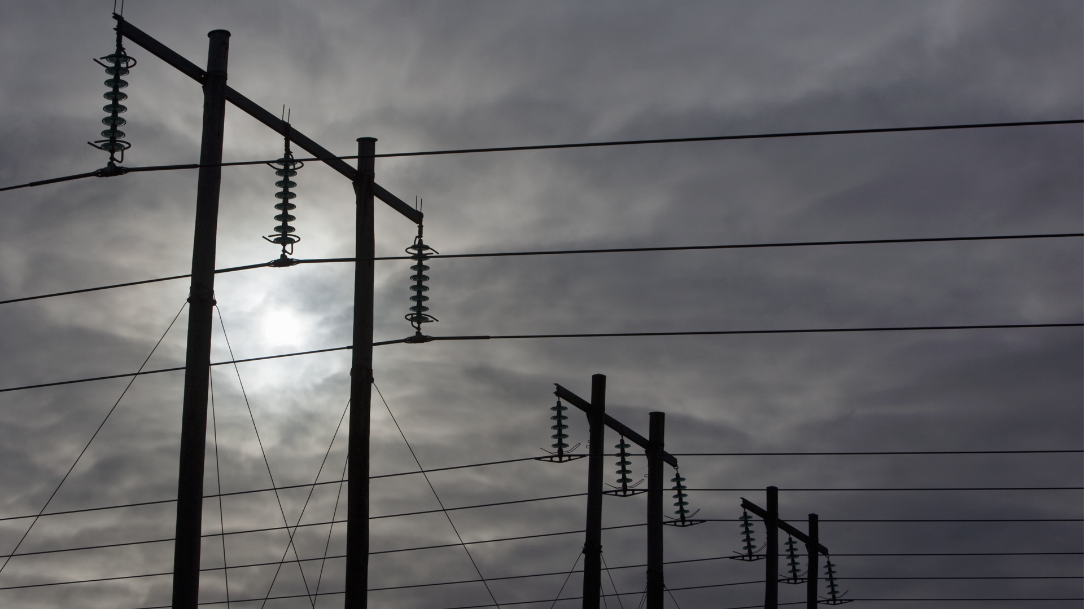
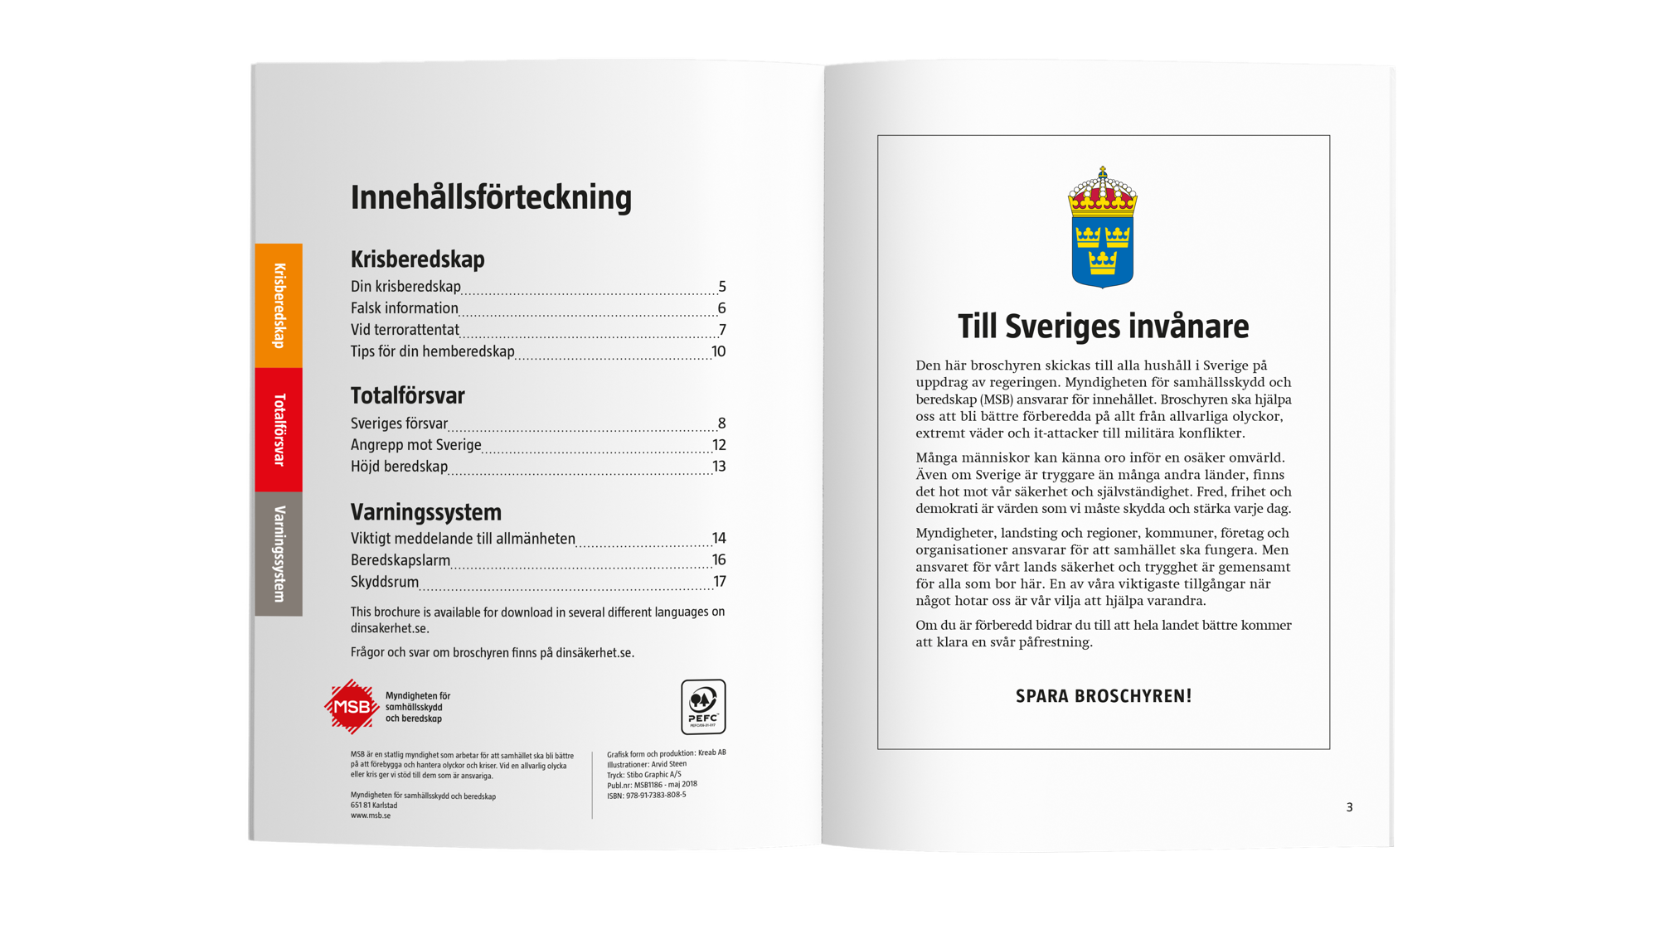
Notes:
FACTS
In the lead-up to the work on the brochure, MSB assembled a reference group with representatives of a number of actors from various levels of society:
The Swedish Armed Forces, county administrative boards, municipalities, the Swedish Association of Local Authorities and Regions, the National Food Agency, the Energy Agency, volunteer defence organisations, and religious communities.
An early version of the brochure was tested in ten focus groups (a total of over 80 persons) in the autumn of 2017. Many asked for concrete advice and tips (checklists) on how to prepare their homes for various crises, saying that this was information they lacked and which generally needed to be improved.
MSB also carried out a pilot study in the autumn of 2017 which showed that the public has limited knowledge about the total defence as well as about home preparedness. The study also showed that a majority felt that issues such as threats, risks, and preparedness are important and that an information brochure in the post would be a good initiative. (Hot och beredskap i Sverige - om allmänhetens kunskap och inställning [Threats and Preparedness in Sweden - on the public’s knowledge and attitudes], MSB/Demoskop 2017)
The brochure uses the signal colours red and orange, where information ranges from peace-time crises and crisis preparedness (orange) and military threats and total defence (red).
BACKGROUND
The contents and design of the brochure has been based on feedback from various parties in society. Many different actors have been involved in the process and have been able to influence the contents. Before starting work on the brochure, MSB assembled a reference group of representatives from the Swedish Armed Forces, SALAR, county administrative boards, central authorities, volunteer organisations, religious communities, and individual municipalities.
MESSAGE
While Sweden is a safe country to live in, compared to many other countries, there are various threats to our safety and security. Government agencies, companies, and organisations have a major responsibility to ensure that we can feel safe living in our country and that society will continue to function under difficult circumstances. But an important recurring message in the brochure is that everyone living in Sweden has a responsibility for and is part of Sweden’s overall preparedness. Everyone is needed and everyone needs to contribute. This is emphasised specifically on page 3 of the brochure. Well-informed and committed citizens form a crucial part of Sweden’s total ability to face various threats. The more prepared people are, the better are our opportunities to help others in need.
The brochure can act as a message and knowledge platform for information to the public, to be used by municipalities, county administrative boards, volunteer defence organisations, adult education institutions, and schools in order to increase people’s resilience.

Slide 4
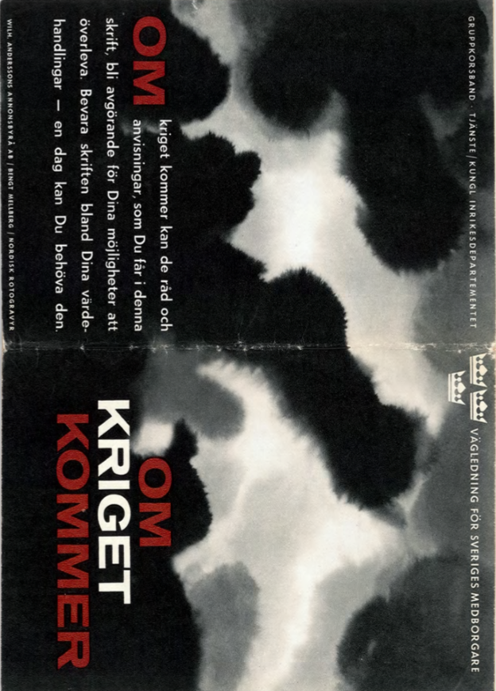
Notes:
FACTS
Brochures on the population’s preparedness have been distributed on three prior occasions: 1943 (the yellow brochure in the middle), 1952 (the orange brochure on the right) and 1961 (the brochure on the left). In other words, it has been 57 years since the last brochure was distributed. The three previous brochures discussed the public’s preparedness in the event of a military attack. The information included what various warning systems sound like, for example air raid sirens and preparedness alarms, what to do if you hear the alarms, how shelters work, how to protect yourself against various weapons, and what to do in an evacuation scenario.
MESSAGE
In naming the 2018 brochure, MSB chose to refer back to the older editions of the brochure. The contents of the latest edition also have some similarities to the previous ones. Examples include information on various warning systems, disinformation campaigns and shelters. The most significant difference compared to previous editions is that the range of threats is broader and more complex than during World War II and the Cold War. Current threats include everything from the consequences of climate chance to terrorist attacks, cyber threats, and military attacks.
MORE INFORMATION MSB’s commission included producing and sending out an information brochure at a specific point in time. MSB currently has no commission to continue publishing this type of information materials.

Slide 5
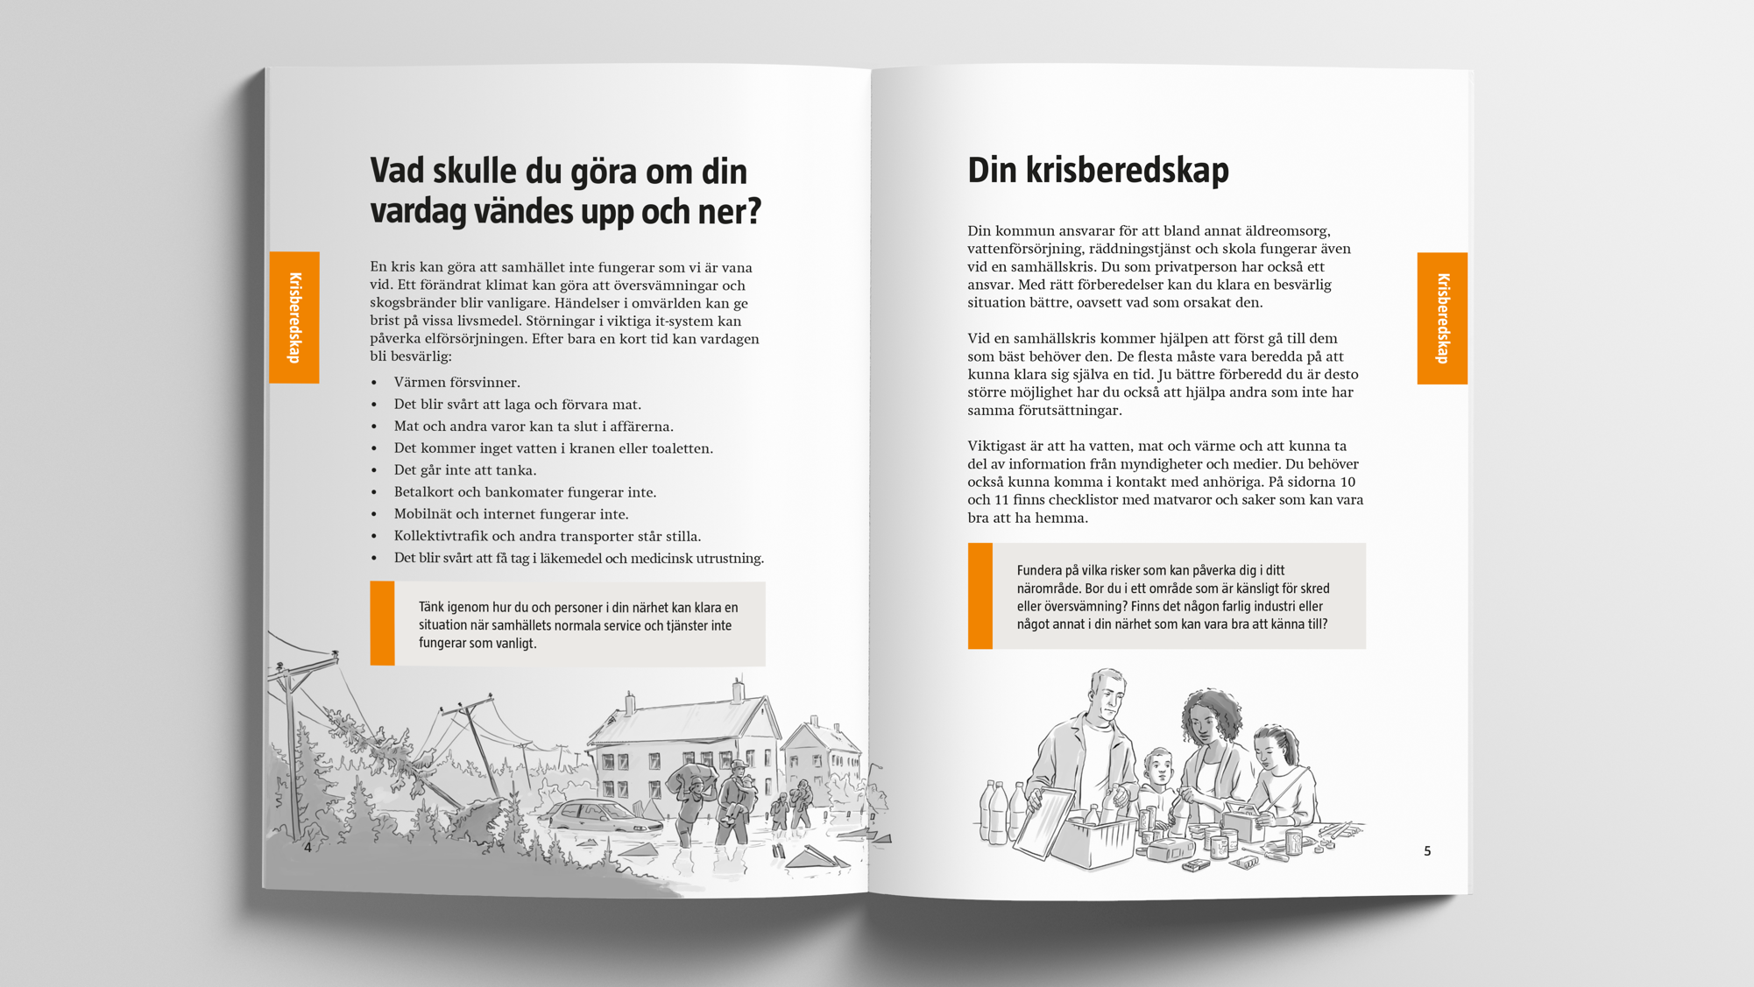
Notes:
FACTS
In the first pages of the brochure, we describe the fundamentals of private individuals and households’ role and participation in our joint safety and preparedness. Here, we also formulate the basic messages regarding responsibility and self-preparedness/home preparedness, as well as facts about what a societal crisis is and how it may affect our everyday life.
BACKGROUND
In MSB’s commission to produce national information material for the households (the brochure), the Government specifically emphasised the need to increase awareness of individual responsibility for our shared security and preparedness, as well as the need for increased knowledge and insight into how crises can affect both society and individuals, and what to do in concrete terms to improve your own preparedness.
We lay the groundwork for our preparedness in peacetime. Municipalities, government agencies, companies, and organisations have a major responsibility for ensuring that we can live in a safe and secure country and that important functions such as power and water supplies remain operational during a crisis. But everyone living in our country also has a responsibility, a responsibility for their own life and property, which remains even during the most serious societal challenges. Well-informed and committed citizens are an important asset to allow society as a whole to handle serious challenges.
MESSAGE
Prepare to manage on your own without support from society for a period of time. While Sweden is safer than many other countries, there are threats to our security and our sovereignty. Prepare and plan to manage by yourself without society’s support for at least a few days, or as long as you are able based on your circumstances and needs. In the event of a crisis, society’s resources will first and foremost be used to help those most in need. If you are prepared, you can help others who are less capable of caring for themselves, and you can contribute to the country’s general capacity to deal with a difficult challenge.
- Stay informed. Learn about different threats, what can happen and how various events can affect society, as well as the daily lives of you, your friends and your family. Find out how your municipality and the municipal services are affected by a serious incident, and what you as a citizen should do if something happens. Learn about home preparedness and how you can prepare to handle a difficult situation as well as possible.
- Get involved. You are needed and your contribution makes a difference. Take a first aid course at work, learn how a defibrillator works, or start a study circle in home preparedness in your housing cooperative or your religious community. You can also get involved in a non-profit organisation, such as the volunteer defence organisations, which play an important part when a serious incident takes place.

Slide 6
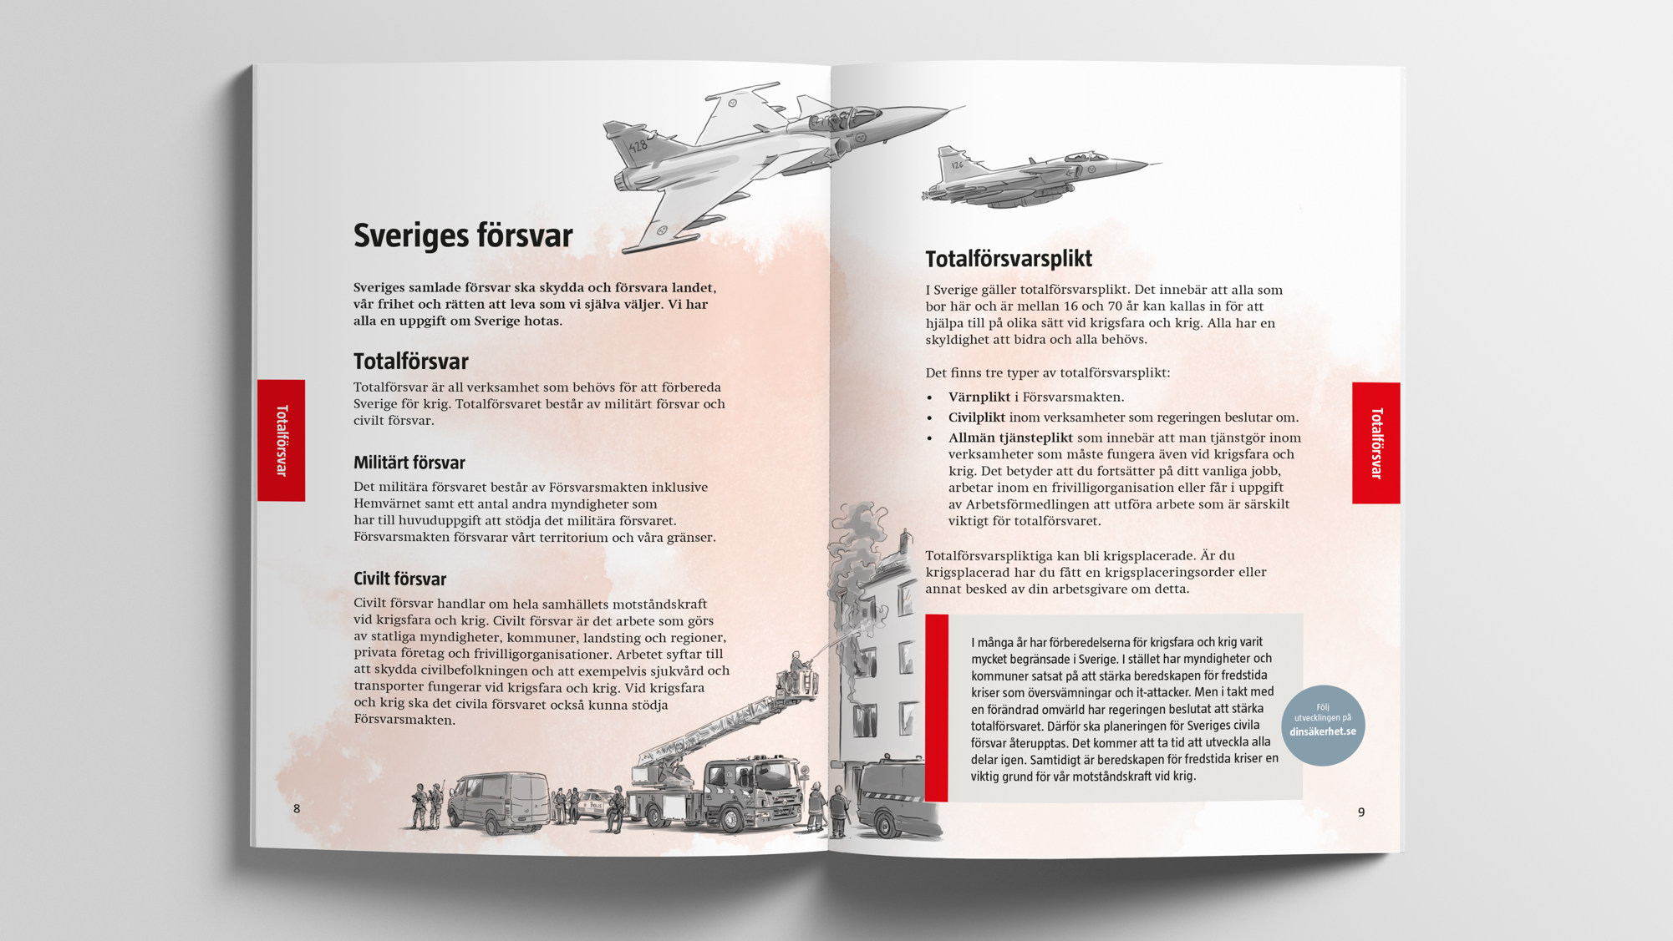
Notes:
FACTS
In its commission to MSB, the Government made it clear that the national information initiative was to contribute to increased public knowledge about how to also prepare for heightened alert levels and, in the worst case, war. This in turn shall be viewed in light of changing global circumstances and the decision to strengthen Sweden’s total defence. The information in the brochure concerning heightened alert levels and war gives a brief summary of the components of Sweden’s total defence which we know to be sustainable over time. Much work and planning remains to be done in the civil defence sector when it comes to shelters, warning systems, and compulsory total defence service. For up to date information, we refer to dinsäkerhet.se.
BACKGROUND
We must be able to withstand various types of attacks on our country. We are currently the target of attacks on important IT systems as well as disinformation campaigns. We can also be affected by conflicts in nearby regions.
The security policy situation in Sweden’s immediate vicinity and in Europe has deteriorated in recent years. The global situation is also deemed to be unstable. A disruption elsewhere can for example affect Sweden’s imports of food, medicine, information technology, and other necessary goods and services.
MESSAGE
For many years, preparations for war and the risk of war have been very limited. Instead, government agencies and municipalities have focused on improving the preparedness for future crises such as floods and IT attacks. But as the global situation has changed, the Government has decided to strengthen the country’s total defence. It will take time to develop all components. At the same time, preparedness for peacetime crises is an important component to our resilience in the event of war. For private individuals, home preparedness is important regardless of what the challenge to society or our country consists of, a cyber attack, extreme weather, or a military conflict in our immediate vicinity.
You are needed and your contribution makes a difference. Take a first aid course at work, learn how a defibrillator works, or start a study circle in home preparedness in your housing cooperative or your religious community. You can also get involved in a non-profit organisation, such as the volunteer defence organisations which play an important part when a serious incident takes place.
MORE INFORMATION
The text in the red box on page twelve has led to many questions and reactions. “If Sweden is attacked by another country, we will never give up. All claims that resistance will cease are false.” This formulation is based on the Swedish constitution and the national security strategy which states that our country’s sovereignty and independence shall be defended at all times. The formulation in the brochure has also been approved by representatives of the Government. There may be situations where this approach may be challenging to say the least, but MSB cannot speculate on what might happen in such a situation.

Slide 7
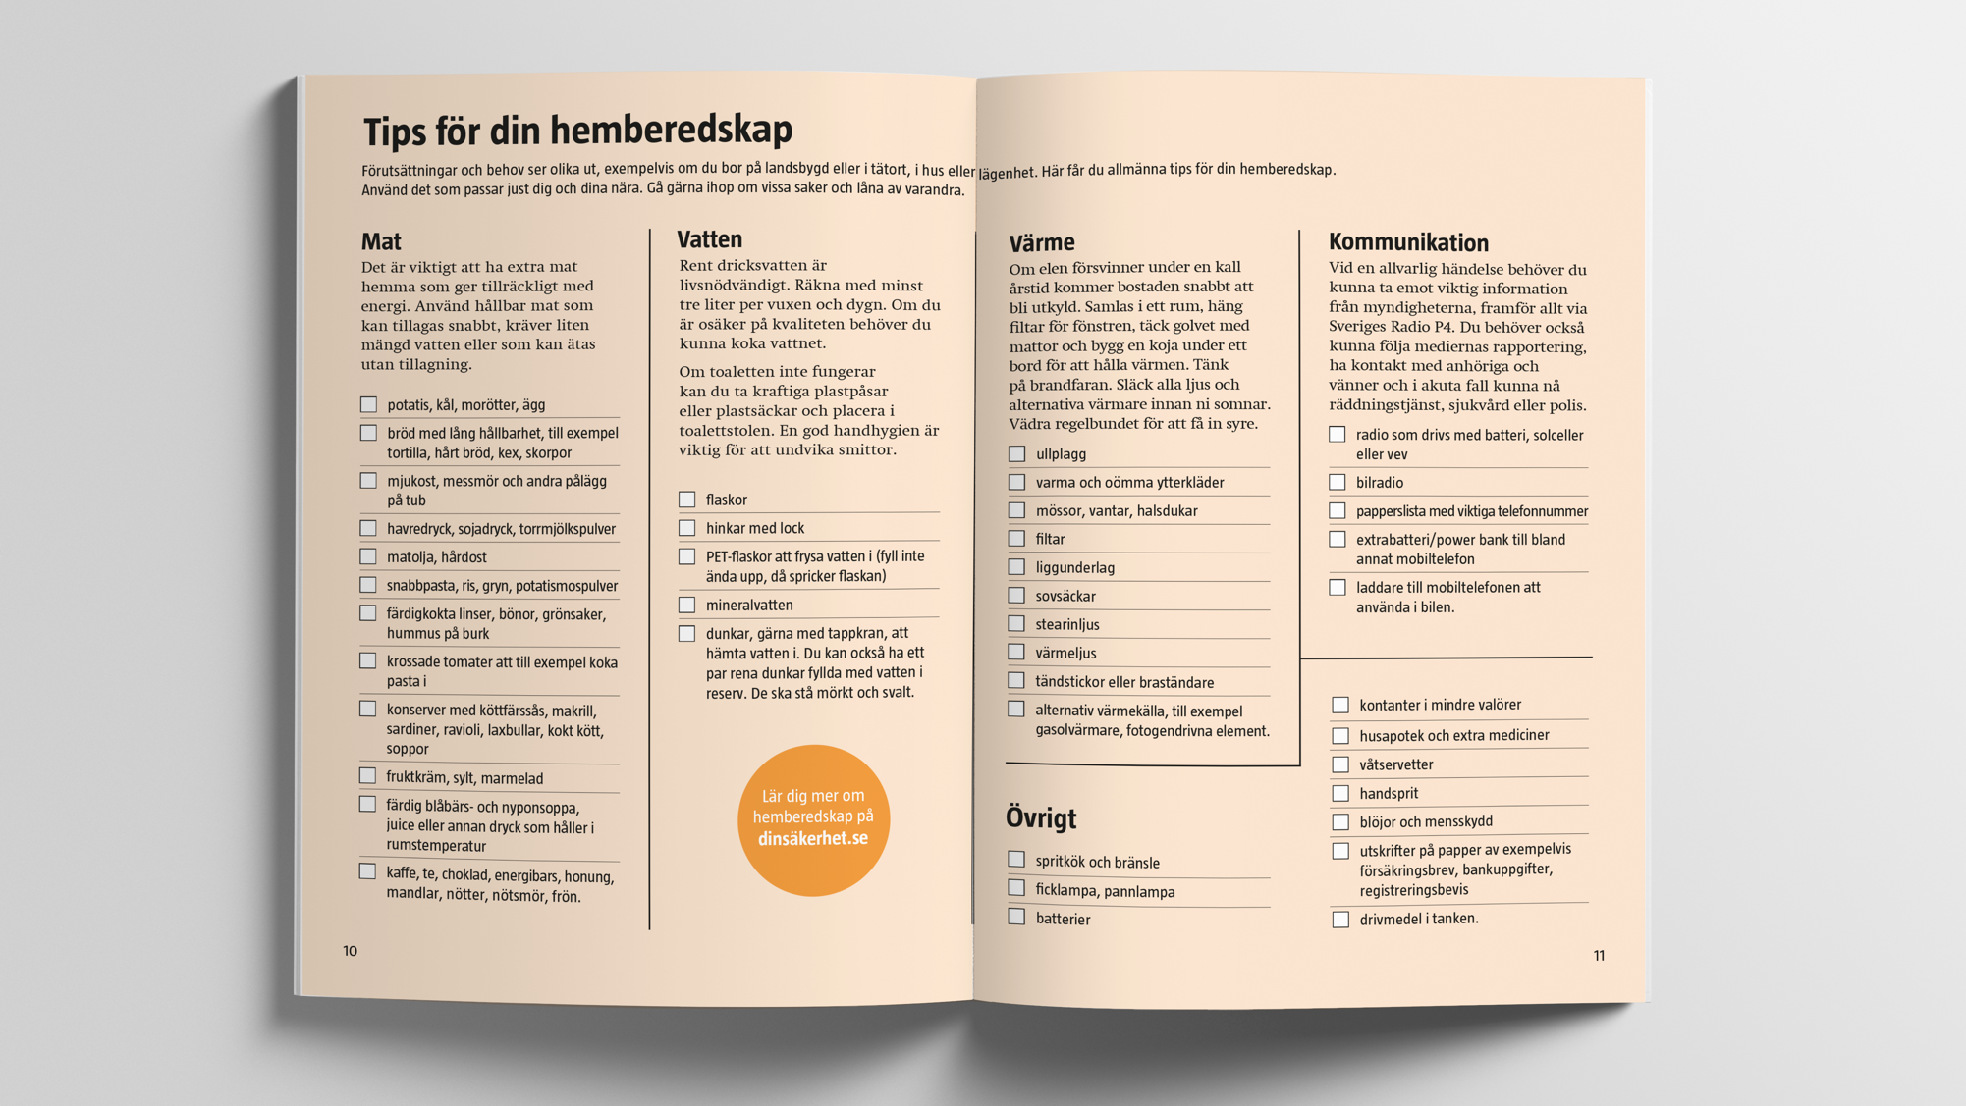
Notes:
FACTS
The centrefold of the brochure makes the central message of the material concrete: Everyone who is able must take responsibility for caring for their own most fundamental needs – food, water, heat, and communication – for a period of time without society’s support. This is necessary as the public resources must first and foremost be spent on those in greatest need. The tips and advice in the checklists are general in nature. Everyone must base their actions on their own household’s specific needs and circumstances.
BACKGROUND
Ten different focus groups consisting of people of different ages and living conditions were given an early version of the brochure and asked to provide comments. Many specifically requested checklists of what to keep in the home and how to prepare. They wanted concrete, clear, and simple information. In the end, MSB decided to make the centrefold a checklist.
MESSAGE
Home preparedness does not need to be hard. Start by seeing what you already have at home, and then add to your inventory over time. Wish for a hand-operated radio as a gift. Suggest that your landlord or housing cooperative buys a stock of items to share. You will be thankful of whatever steps you have taken, no matter how small, when something happens.
Conditions and needs differ between households, as well as between rural and urban areas. The checklist gives general recommendations of things which can be good to have at home, but everyone must act on their own or their household’s specific needs.
Plan and prepare to manage without society’s help for at least a few days, up to a week or more if you are able. Take stock of your own needs and the needs of those close to you. If you are prepared, you help everyone around you, and the country as a whole, to get through a trying time better. It can take a long time for everyday life to return. But if you have what you need for the first few days, you will have time to consider your situation and make well-informed decisions about your future actions. It can also mean that you do not have to queue for goods which are in high demand and may run out during those days.
MORE INFORMATION
In a 2019 MSB survey, 45 per cent of respondents (approx. 2,560 persons) stated that they can get by without society’s support for three days or more. (Impact assessment of the brochure If Crisis or War Comes, MSB/Enkätfabriken 2019)
In a survey conducted by MSB/Demoskop in 2018, after Crisis Preparedness Week and the distribution of the brochure If Crisis or War Comes , out of 1,500 persons, 28 per cent said that they had good or very good home preparedness. 33 per cent considered their home preparedness to be non-existent/almost non-existent.
At the same time, a majority (82 per cent) consider themselves to have major/very major responsibility for managing daily life when society’s services are not working as you are used to. 75 per cent feel that issues concerning safety and preparedness for them and their family in the event of failing societal services is important.
MSB does not specify for how long households should be prepare to care for themselves without society’s support. This means that we do not, for example, use the 72 hour message relating to the home preparedness for several reasons:
It can be perceived as a guarantee that society’s support will return after three days. Fundamentally, it is a matter of people’s trust in the authorities tasked with handling the crisis. There are many examples of incidents where it has taken many days before contact or support is re-established by society.
A societal crisis with serious disruptions to important societal functions will have comprehensive consequences and may entail major challenges for authorities, companies, and organisations as well as for the general population for a very long time. Weeks, months, or even longer periods of time may pass before society is back to normal. It is important to make individuals aware of this from the start.
By their very nature, crises means that there are no guaranteed time frames. The time frames are instead dependent on what has happened and how many have been affected.

Slide 8
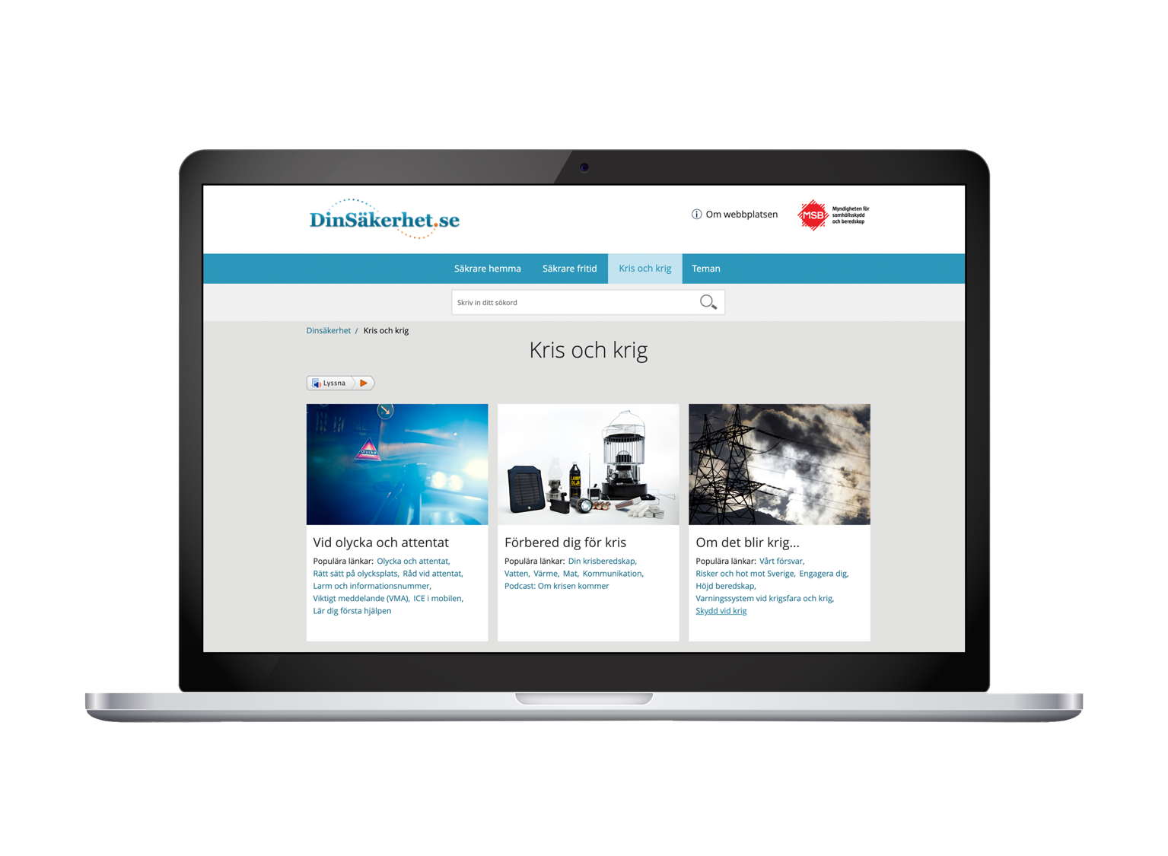
Notes:
FACTS
In-depth and updated information about the contents of the brochure If Crisis or War Comes is available on MSB’s website for private individuals, dinsäkerhet.se. Under the heading Crisis and war, the website provides information on everything from home preparedness to various threats against our country. Here you will find checklists, episodes of MSB’s podcast series Om krisen kommer [If crisis comes], frequently asked questions, videos on home preparedness, and digital versions of the brochure in various languages and formats.
MESSAGE
The information found on dinsäkerhet.se provides general, up-to-date, useful information on safety and preparedness, aimed at private individuals. Municipalities and other actors can direct people and link to the website, which means they do not need to spend their own resources on general risk information. They can instead focus on location-specific information to its inhabitants. Use MSB’s online Guide for risk communication (in Swedish) at msb.se/riskkommunikation for tips and advice on how to do this.

Slide 9
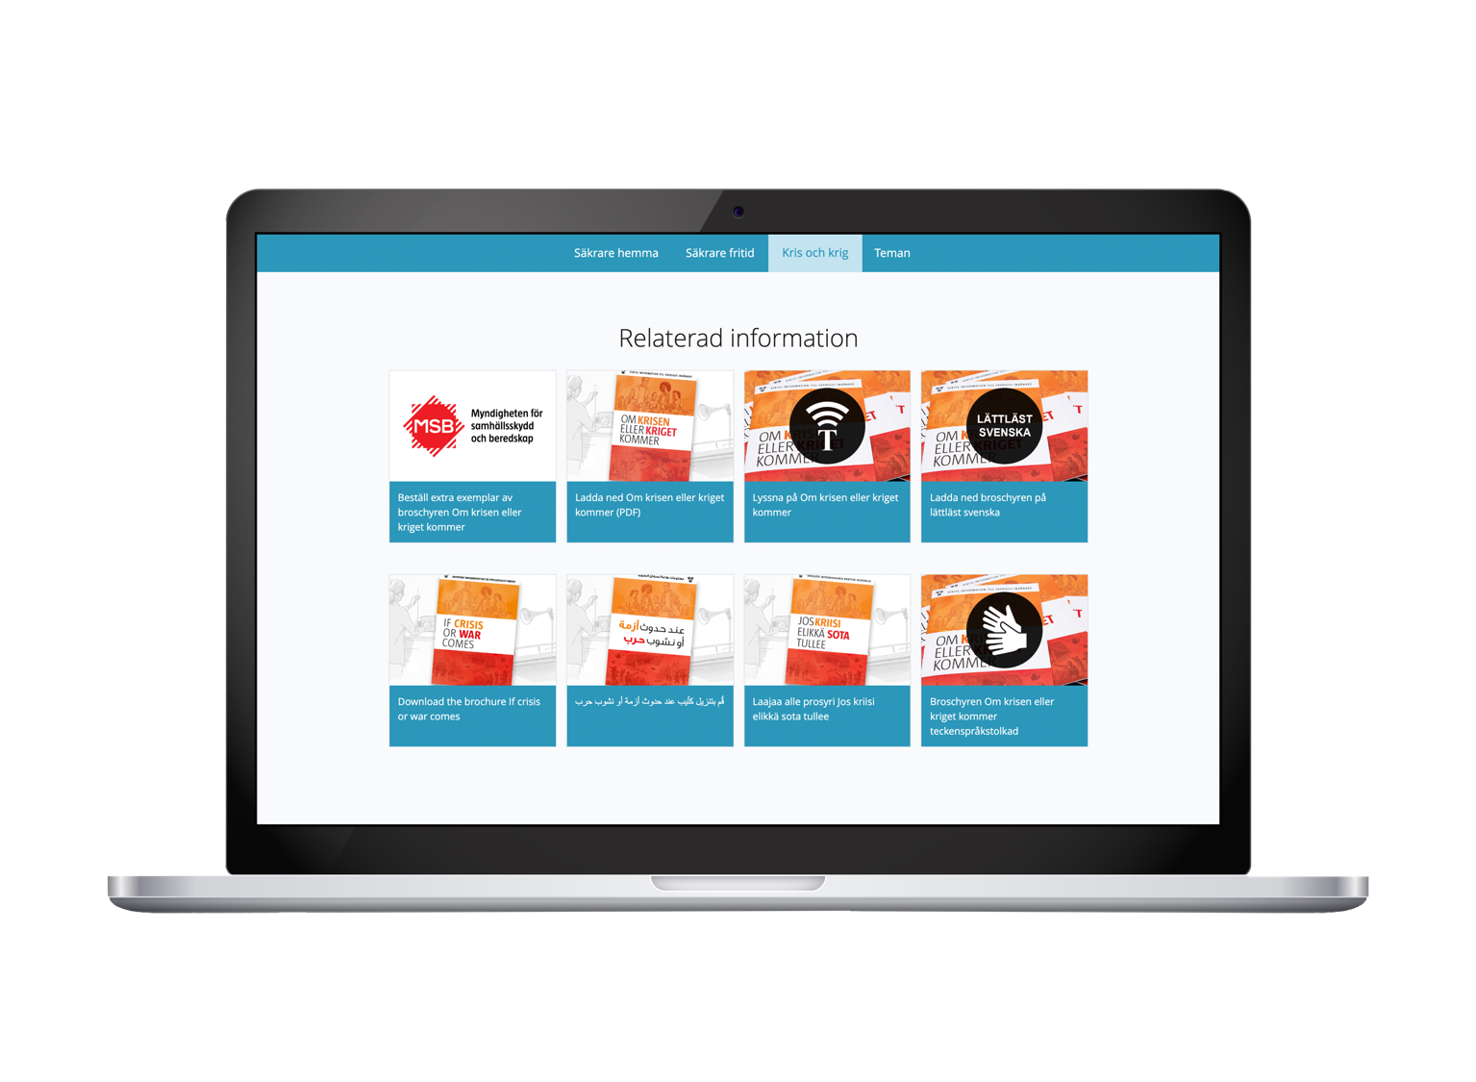
Notes:
FACTS
MSB has translated digital versions of the brochure into 16 different languages. Sweden’s five official minority languages: Finnish, Yiddish, Meänkieli, Romani Chib (Arli), Sami
(North, South and Lule Sami), and a number of other common mother tongues or second languages: Arabic, Dari, English, French, Persian, Russian, Somali, Spanish, and Tigrinya.
The information in the brochure is also available in simplified Swedish. This means that the writing has been simplified compared to the original. This version can be an alternative for people with basic Swedish skills or persons with reading and writing difficulties. The information is also available in sign language, recorded in simple Swedish and English, in Braille and as a CD.
The various translations and versions can be found as files optimised for multi-function printers on msb.se/krisberedskapsveckan. If your organisation does not have one, contact a print shop.
The PDF files on dinsäkerhet.se are only intended to be read on monitors and do not have the appropriate resolution for printing.
MESSAGE
The brochure contains important information that everyone, regardless of needs and ability, is entitled to. MSB has therefore focused on availability and has translated the digital version of the brochure into 16 languages. The information is also available in sign language, recorded in simple Swedish and English, in Braille and on CD through a collaboration with the Swedish Agency for Accessible Media.
Each actor decides if they want to offer print copies in other languages than Swedish. If your organisation is part of a Finnish, Sami, or Meänkieli administrative areas, we recommend that you inform the target groups that the brochure has been translated. Also try to reach the target groups for Romani and Yiddish. The translations can be found at www.dinsäkerhet.se.
MORE INFORMATION
MSB has chosen to translate the brochure into Sweden’s five official minority languages, as the law states that these languages shall be promoted and protected. This mainly applies to Finnish, Meänkieli, and Sami, but MSB also chose Romani Chib and Yiddish. Other languages include common mother tongues and second languages among people who have come to Swedish in the past five years. The selection is in line with the information on www.informationsverige.se. This is a portal aimed at persons who are new to Sweden and who quickly and easily need to find information about Swedish society. MSB followed the recommendation provided by the actors behind the website, the Migration Agency, the Swedish Public Employment Service, and the County Administrative Board in Västra Götaland, in the spring of 2018.

Slide 10
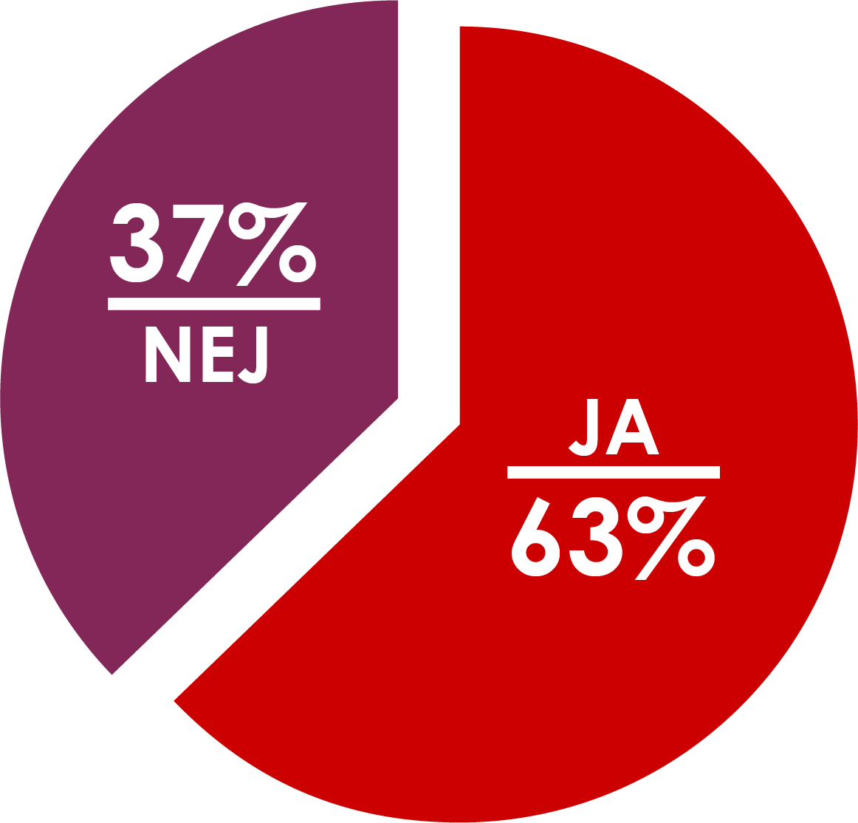
Have you, as a result of the brochure, reflected more on how you would cope with daily life in the event of a crisis or war?
Notes:
FACTS
In a follow-up survey in January 2019 aimed at the general public (8 months after the brochures were sent out), MSB asked if the respondents had begun reflecting more on how they would cope with a difficult situation since reading the brochure. A majority of respondents had, as a result of the brochure, reflected more on how you would cope with daily life in the event of a crisis or war.
As a result of the brochure,
- 13 per cent have improved their home preparedness.
- 26 per cent plan to improve their home preparedness.
- 34 per cent have spoken to friends and relatives about the contents of the brochure.
- 44 per cent have done nothing.
The most common reason for not having done anything to improve your home preparedness is that you intend to do so in the future, and that you think that the risk of a crisis or war is very small.
Of those who have read the brochure, 45 per cent believe that they would be able to get through three days without society’s support in the event of a long-term power outage.
(Impact assessment of the brochure If Crisis or War Comes, MSB/Enkätfabriken April 2019)
MESSAGE
The brochure has helped increase the public’s risk awareness. Reflection is important for mental preparedness and a first step towards action and concrete commitment. We now move on to offering accessible and useful information about our shared safety and preparedness to everyone living in Sweden, in order to create a resilient population. Increased resilience in individuals means that people are well-informed, involved, committed, and taking concrete action to improve their personal preparedness.

Slide 11
For more information about...
... the planning of the Crisis Preparedness Week and follow-up of the brochure: Our newsletter krisberedskapsveckan@msb.se and msb.se/krisberedskapsveckan
preparedness for crises and war for private individuals: dinsäkerhet.se/krisochkrig

